Slide 1
Multiclass Classification
Alan Ritter
(many slides from Greg Durrett, Vivek Srikumar, Stanford CS231n)

Slide 2
Administrivia
Homework 1 due on Wednesday
Office Hours
Friday -> Monday next week @ 4:30pm
Updated Reading Assignments
Prof. Wei Xu will present lectures next week
Waitlist Policy:
If there is space, I will send you an email today.

Slide 3
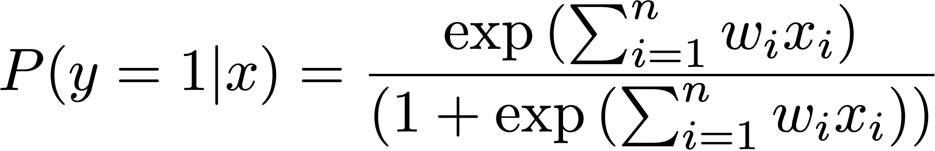
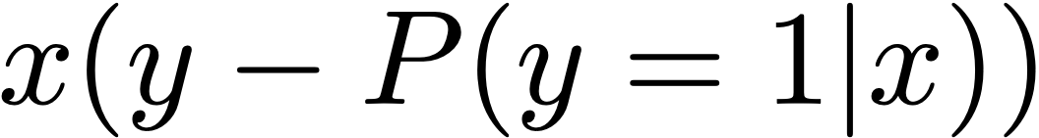
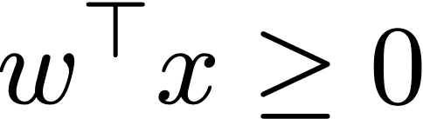
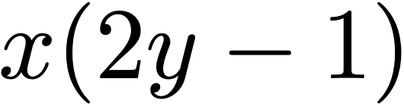
Recall: Binary Classification
Logistic regression:
Decision rule:
Gradient (unregularized):
SVM: quadratic program to minimize weight vector norm w/slack
Decision rule:
(Sub)gradient (unregularized): 0 if correct with margin of 1, else

Slide 4
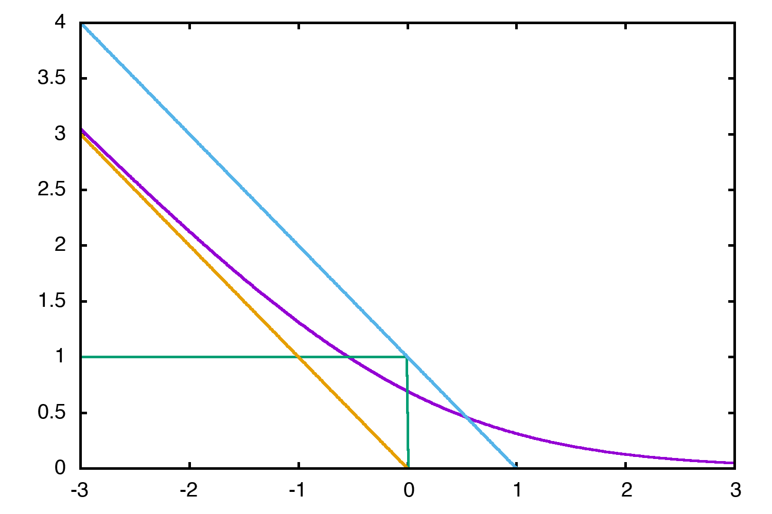
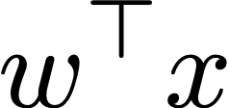
Loss Functions
Hinge (SVM)
Loss
0-1 (ideal)
Logistic
Perceptron

Slide 5
This Lecture
Multiclass fundamentals
Feature extraction
Multiclass logistic regression
Multiclass SVM
Optimization

Slide 6
Multiclass Fundamentals

Slide 7
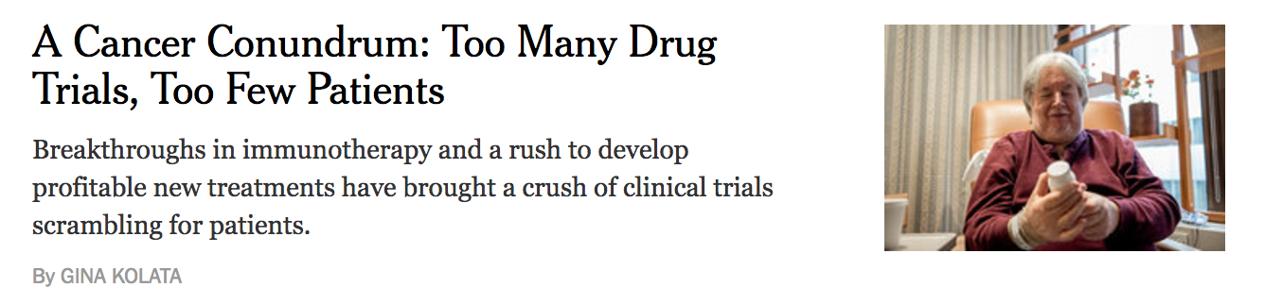
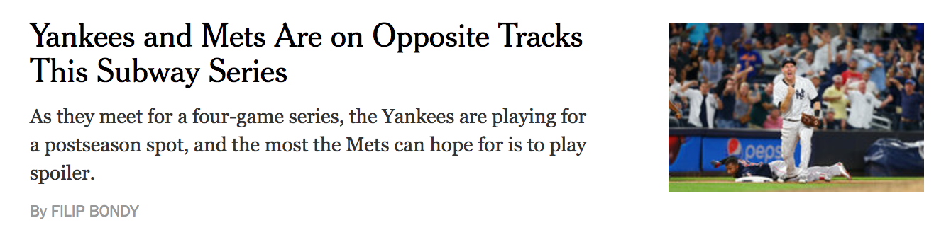
Text Classification
Health
Sports
~20 classes

Slide 8
Image Classification
Dog
Car
Thousands of classes (ImageNet)

Slide 9

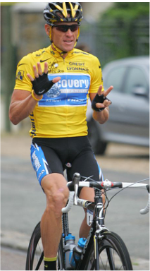
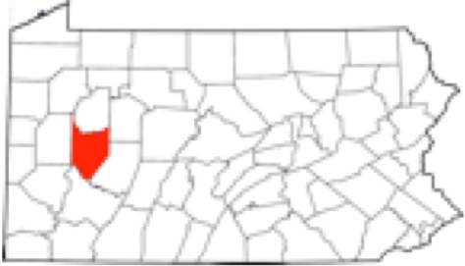
Entity Linking
Armstrong County is a county in Pennsylvania…
Although he originally won the event, the United States Anti-Doping Agency announced in August 2012 that they had disqualified Armstrong from his seven consecutive Tour de France wins from 1999–2005.
Lance Edward Armstrong is an American former professional road cyclist
?
?
4,500,000 classes (all articles in Wikipedia)

Slide 10
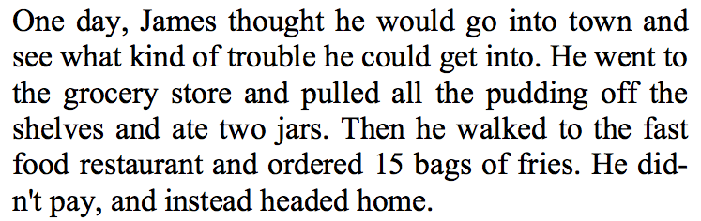
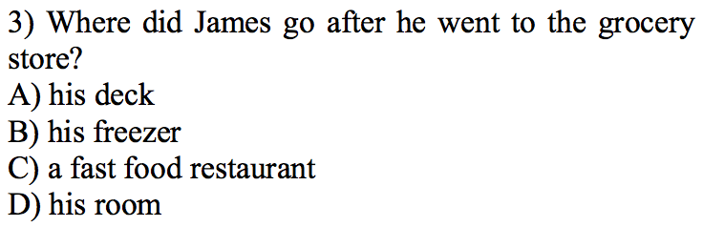
Reading Comprehension
Multiple choice questions, 4 classes (but classes change per example)
Richardson (2013)

Slide 11
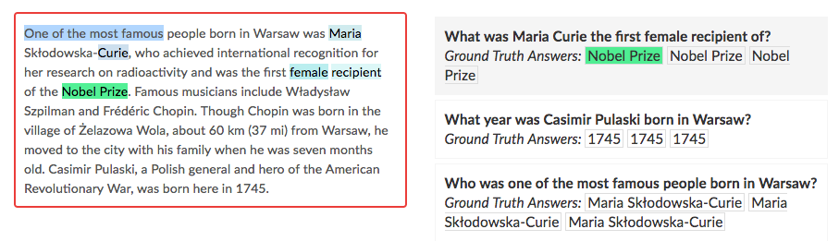
Reading Comprehension
Pick a span of the input (more structured but can still be viewed as multiclass)

Slide 12
Binary Classification
Binary classification: one weight vector defines positive and negative classes
+
+
+
+
+
+
+
+
-
-
-
-
-
-
-
-
-

Slide 13
Multiclass Classification
Can we just use binary classifiers here?
1
1
1
1
2
1
1
2
2
2
3
3
3
3

Slide 14
Multiclass Classification
One-vs-all: train k classifiers, one to distinguish each class from all the rest
How do we reconcile multiple positive predictions? Highest score?
1
1
1
1
1
1
1
1
2
1
1
2
1
1
2
2
2
2
2
2
3
3
3
3
3
3
3
3

Slide 15
Multiclass Classification
Not all classes may even be separable using this approach
3
1
1
3
1
1
2
2
3
3
1
3
1
2
2
3
2
2
Can separate 1 from 2+3 and 2 from 1+3 but not 3 from the others (with these features)

Slide 16
Multiclass Classification
All-vs-all: train n(n-1)/2 classifiers to differentiate each pair of classes
Again, how to reconcile?
1
1
1
1
1
1
1
1
2
1
1
1
1
2
2
2
3
3
3
3

Slide 17
Multiclass Classification
Binary classification: one weight vector defines both classes
Multiclass classification: different weights and/or features per class
1
1
+
+
1
+
1
+
+
+
1
+
2
1
+
2
2
2
3
-
-
-
3
-
-
-
3
3
-
-
-

Slide 18
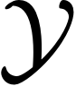
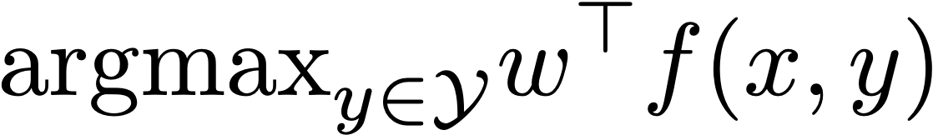
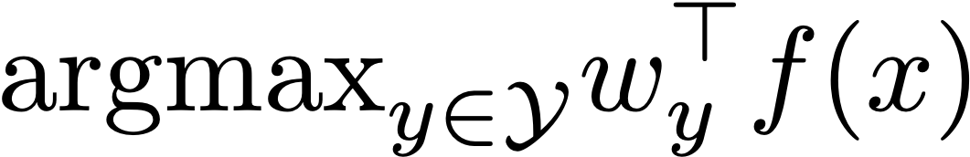
Multiclass Classification
Formally: instead of two labels, we have an output space containing a number of possible classes
Same machinery that we’ll use later for exponentially large output spaces, including sequences and trees
features depend on choice of label now! note: this isn’t the gold label
Decision rule:
Multiple feature vectors, one weight vector
Can also have one weight vector per class:
The single weight vector approach will generalize to structured output spaces, whereas per-class weight vectors won’t

Slide 19
Feature Extraction

Slide 20
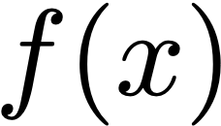
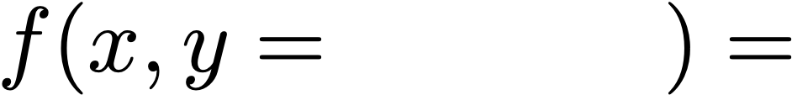
Block Feature Vectors
Decision rule:
Health
too many drug trials, too few patients
Sports
Base feature function:
Science
= I[contains drug], I[contains patients], I[contains baseball]
= [1, 1, 0]
feature vector blocks for each label
Health
[1, 1, 0, 0, 0, 0, 0, 0, 0]
I[contains drug & label = Health]
Sports
[0, 0, 0, 1, 1, 0, 0, 0, 0]
Equivalent to having three weight vectors in this case
Notes:
f(x,y=\ \ \ \ \ \ \ \ \ \ \ )=

Slide 21
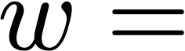
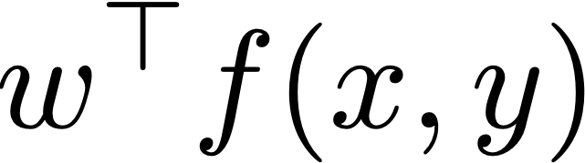
Making Decisions
Health
too many drug trials, too few patients
Sports
Science
= I[contains drug], I[contains patients], I[contains baseball]
Health
[1, 1, 0, 0, 0, 0, 0, 0, 0]
Sports
[0, 0, 0, 1, 1, 0, 0, 0, 0]
“word drug in Science article” = +1.1
[+2.1, +2.3, -5, -2.1, -3.8, 0, +1.1, -1.7, -1.3]
Health: +4.4
Sports: -5.9
Science: -0.6
=
argmax

Slide 22
Another example: POS tagging
Classify blocks as one of 36 POS tags
the router
blocks
the packets
NNS
Example x: sentence with a word (in this case, blocks) highlighted
VBZ
NN
Extract features with respect to this word:
DT
…
f(x, y=VBZ) = I[curr_word=blocks & tag = VBZ], I[prev_word=router & tag = VBZ] I[next_word=the & tag = VBZ] I[curr_suffix=s & tag = VBZ]
not saying that the is tagged as VBZ! saying that the follows the VBZ word

Slide 23
Multiclass Logistic Regression

Slide 24
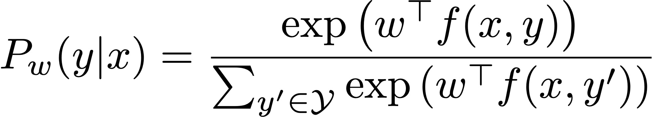
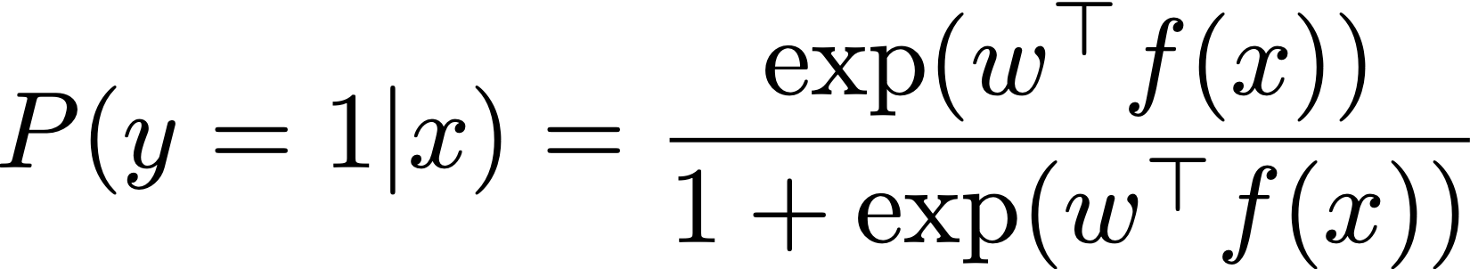
Multiclass Logistic Regression
Compare to binary:
sum over output space to normalize
negative class implicitly had f(x, y=0) = the zero vector
Notes:
P(y|x) = \frac{\exp\left(w^\top f(x,y)\right)}{\sum_{y'} \exp\left(w^\top f(x,y')\right)}
P(y_j=1|x_j) = \frac{\exp(w^\top f(x)}{1 + \exp(w^\top f(x)}
%\mathcal{L}(x,y) = \sum_{j=1}^n \log P(y_j | x_j)
= \sum_{j=1}^n \left( w^\top f(x_j,y_j) - \log \sum_y \exp(w^\top f(x_j,y)) \right)

Slide 25
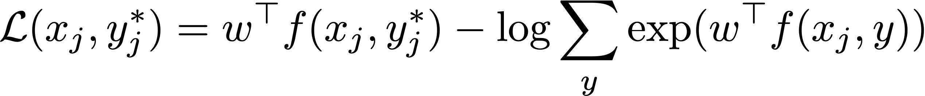
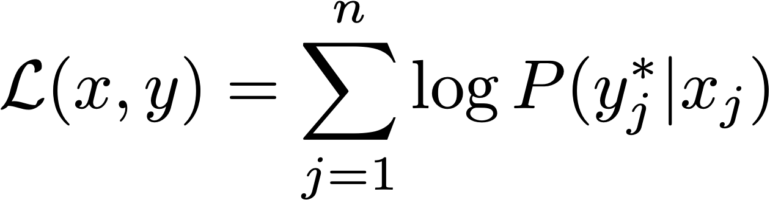
Multiclass Logistic Regression
Softmax function
sum over output space to normalize
Why? Interpret raw classifier scores as probabilities
too many drug trials,
too few patients
probabilities
must be >= 0
probabilities
must sum to 1
Health: +2.2
6.05
0.21
log(0.21) = - 1.56
1.00
Sports: +3.1
exp
22.2
normalize
0.77
compare
0.00
Science: -0.6
0.55
0.02
0.00
unnormalized
probabilities
probabilities
correct (gold)
probabilities
Notes:
P(y|x) = \frac{\exp\left(w^\top f(x,y)\right)}{\sum_{y'} \exp\left(w^\top f(x,y')\right)}
P(y_j=1|x_j) = \frac{\exp(w^\top f(x)}{1 + \exp(w^\top f(x)}
%\mathcal{L}(x,y) = \sum_{j=1}^n \log P(y_j | x_j)
= \sum_{j=1}^n \left( w^\top f(x_j,y_j) - \log \sum_y \exp(w^\top f(x_j,y)) \right)

Slide 26
Multiclass Logistic Regression
Training: maximize
i.e. minimize negative log likelihood (NLL) or cross-entropy loss
Image credit: Micheleen Harris
Notes:
P(y|x) = \frac{\exp\left(w^\top f(x,y)\right)}{\sum_{y'} \exp\left(w^\top f(x,y')\right)}
P(y_j=1|x_j) = \frac{\exp(w^\top f(x)}{1 + \exp(w^\top f(x)}
%\mathcal{L}(x,y) = \sum_{j=1}^n \log P(y_j | x_j)
= \sum_{j=1}^n \left( w^\top f(x_j,y_j) - \log \sum_y \exp(w^\top f(x_j,y)) \right)

Slide 27
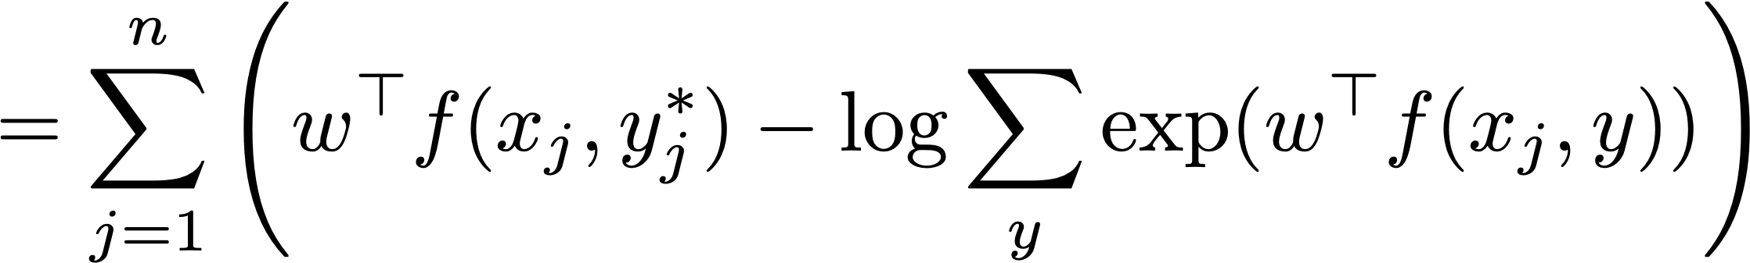
Multiclass Logistic Regression
sum over output space to normalize
Training: maximize
Notes:
P(y|x) = \frac{\exp\left(w^\top f(x,y)\right)}{\sum_{y'} \exp\left(w^\top f(x,y')\right)}
P(y_j=1|x_j) = \frac{\exp(w^\top f(x)}{1 + \exp(w^\top f(x)}
%\mathcal{L}(x,y) = \sum_{j=1}^n \log P(y_j | x_j)
= \sum_{j=1}^n \left( w^\top f(x_j,y_j) - \log \sum_y \exp(w^\top f(x_j,y)) \right)

Slide 28
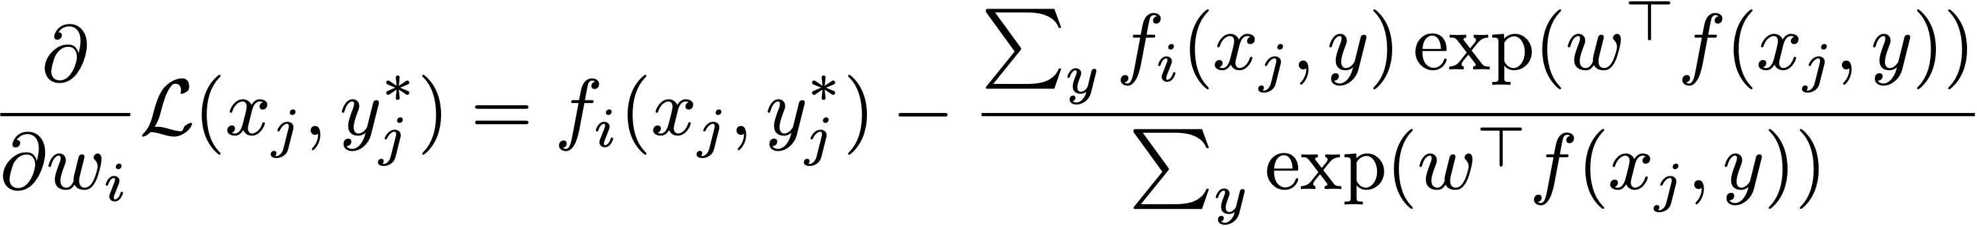
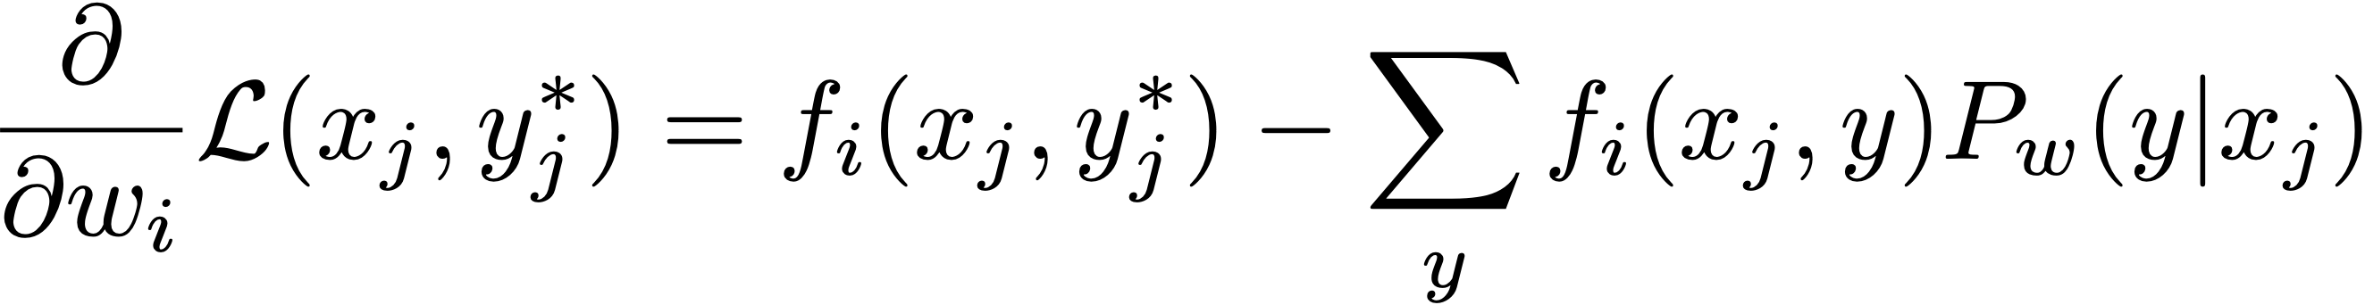
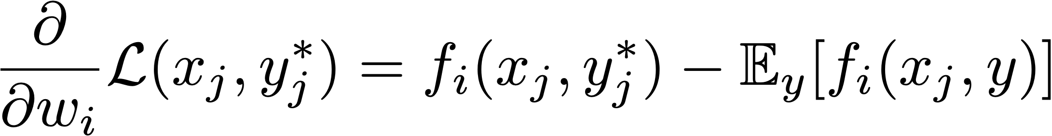
Training
Multiclass logistic regression
Likelihood
model’s expectation of feature value
gold feature value
Notes:
%\mathcal{L}(x_j,y_j) = w^\top f(x_j,y_j) - \log \sum_y \exp(w^\top f(x_j,y))
%\frac{\partial}{\partial w_i} \mathcal{L} (x_j,y_j) = f_i(x_j,y_j) - \sum_y f_i(x_j,y) P_w(y|x_j)

Slide 29
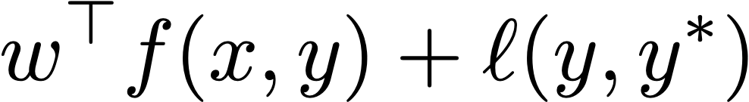
Training
y* =
too many drug trials, too few patients
Health
Health
[1, 1, 0, 0, 0, 0, 0, 0, 0]
Pw(y|x) = [0.21, 0.77, 0.02]
Sports
[0, 0, 0, 1, 1, 0, 0, 0, 0]
gradient:
[1, 1, 0, 0, 0, 0, 0, 0, 0]
— 0.21 [1, 1, 0, 0, 0, 0, 0, 0, 0]
— 0.77 [0, 0, 0, 1, 1, 0, 0, 0, 0]
— 0.02 [0, 0, 0, 0, 0, 0, 1, 1, 0]
= [0.79, 0.79, 0, -0.77, -0.77, 0, -0.02, -0.02, 0]
update :
[1.3, 0.9, -5, 3.2, -0.1, 0, 1.1, -1.7, -1.3]
+ [0.79, 0.79, 0, -0.77, -0.77, 0, -0.02, -0.02, 0]
= [2.09, 1.69, 0, 2.43, -0.87, 0, 1.08, -1.72, 0]
new Pw(y|x) = [0.89, 0.10, 0.01]

Slide 30
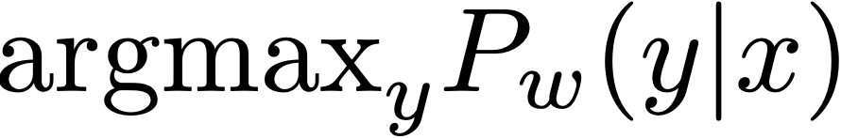
Logistic Regression: Summary
Model:
Inference:
Learning: gradient ascent on the discriminative log-likelihood
“towards gold feature value, away from expectation of feature value”
Notes:
%P_w(y|x) = \frac{\exp\left(w^\top f(x,y)\right)}{\sum_{y' \in \mathcal{Y}} \exp\left(w^\top f(x,y')\right)}
\textrm{argmax}_y P_w(y|x)
%f(x,y^*) - \mathbb{E}_y[f(x,y)] = f(x,y^*) - \sum_y [P_w(y|x) f(x,y)]

Slide 31
Multiclass SVM

Slide 32
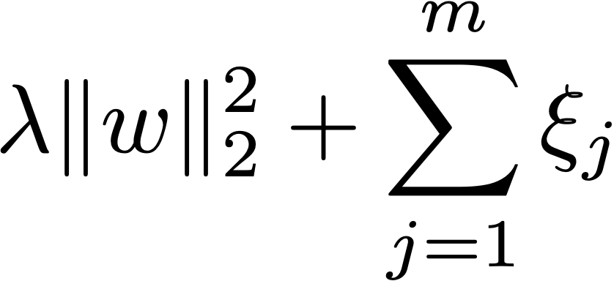
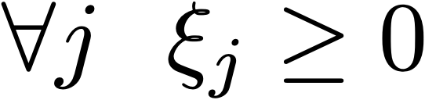
Soft Margin SVM
slack variables > 0 iff example is support vector
Minimize
s.t.
Image credit: Lang Van Tran
Notes:
%\forall j \forall y \in \mathcal{Y}\ \ w^\top f(x_j,y_j^*) \geq w^\top f(x_j, y) + \ell(y,y_j^*) - \xi_j

Slide 33
Multiclass SVM
slack variables > 0 iff example is support vector
Minimize
s.t.
Correct prediction now has to beat every other class
Score comparison is more explicit now
The 1 that was here is replaced by a loss function
Notes:
%\forall j \forall y \in \mathcal{Y}\ \ w^\top f(x_j,y_j^*) \geq w^\top f(x_j, y) + \ell(y,y_j^*) - \xi_j

Slide 34
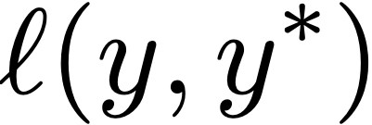
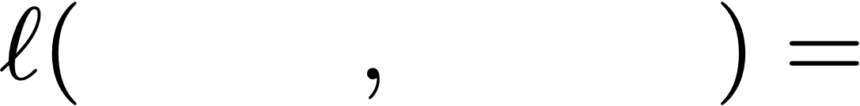
Training (loss-augmented)
Are all decisions equally costly?
Health
too many drug trials, too few patients
Sports
Sports
Science
Predicted
Sports
: bad error
Predicted
Science
: not so bad
We can define a loss function
Sports
Health
3
Science
Health
1

Slide 35

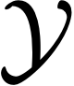
Multiclass SVM
1.3+3
Does gold beat every label + loss? No!
1.8+1
Most violated constraint is Sports; what is ?
2.4+0
= 4.3 - 2.4 = 1.9
Perceptron would make no update here
Health
Science
Sports
Notes:
%\forall j \forall y \in \mathcal{Y}\ \ w^\top f(x_j,y_j^*) \geq w^\top f(x_j, y) + \ell(y,y_j^*) - \xi_j

Slide 36
Multiclass SVM
Minimize
s.t.
One slack variable per example, so it’s set to be whatever the most violated constraint is for that example
Plug in the gold y and you get 0, so slack is always nonnegative!
Notes:
%\forall j \forall y \in \mathcal{Y}\ \ w^\top f(x_j,y_j^*) \geq w^\top f(x_j, y) + \ell(y,y_j^*) - \xi_j

Slide 37
Loss-Augmented Decoding
too many drug trials, too few patients
Health
Loss
Total
Health +2.4
0
2.4
Sports +1.3
3
4.3
argmax
Science +1.8
1
2.8
Sports is most violated constraint, slack = 4.3 — 2.4 = 1.9
Perceptron would make no update, regular SVM would pick Science

Slide 38
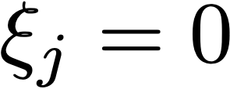
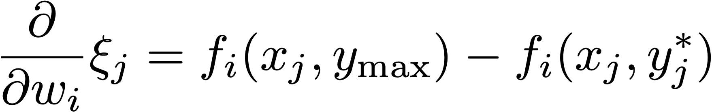
Computing the Subgradient
Minimize
s.t.
If , the example is not a support vector, gradient is zero
Otherwise,
(update looks backwards — we’re minimizing here!)
Perceptron-like, but we update away from *loss-augmented* prediction
Notes:
\xi_j = \textrm{argmax}_y w^\top f(x_j,y) + \ell(y, y_j^*) - w^\top f(x_j, y^*_j)

Slide 39
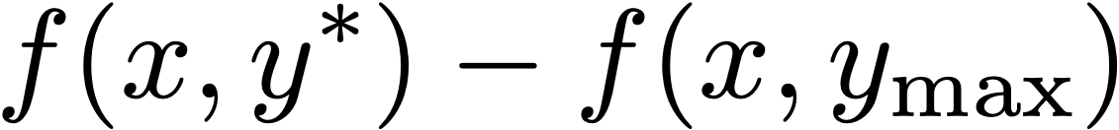
Putting it Together
Minimize
s.t.
(Unregularized) gradients:
SVM:
(loss-augmented max)
Log reg:
SVM: max over s to compute gradient. LR: need to sum over s
Notes:
\xi_j = \textrm{argmax}_y w^\top f(x_j,y) + \ell(y, y_j^*) - w^\top f(x_j, y^*_j)

Slide 40
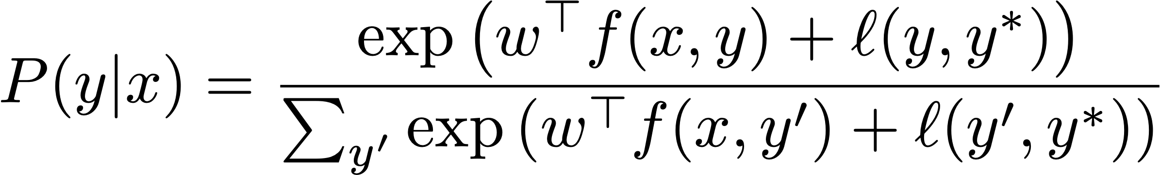
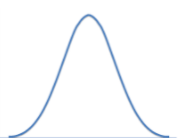
Softmax Margin
Can we include a loss function in logistic regression?
Likelihood is artificially higher for things with high loss — training needs to work even harder to maximize the likelihood of the right thing!
low loss
high loss
low loss
high loss
right answer
Biased estimator for original likelihood, but better loss
Gimpel and Smith (2010)

Slide 41
Entity Linking
Armstrong County is a county in Pennsylvania…
Although he originally won the event, the United States Anti-Doping Agency announced in August 2012 that they had disqualified Armstrong from his seven consecutive Tour de France wins from 1999–2005.
Lance Edward Armstrong is an American former professional road cyclist
?
?
4.5M classes, not enough data to learn features like “Tour de France <-> en/wiki/Lance_Armstrong”
Instead, features f(x, y) look at the actual article associated with y

Slide 42
Entity Linking
Although he originally won the event, the United States Anti-Doping Agency announced in August 2012 that they had disqualified Armstrong from his seven consecutive Tour de France wins from 1999–2005.
Lance Edward Armstrong
Armstrong County
tf-idf(doc, w) = freq of w in doc * log(4.5M/# Wiki articles w occurs in)
the: occurs in every article, tf-idf = 0
cyclist: occurs in 1% of articles, tf-idf = # occurrences * log10(100)
tf-idf(doc) = vector of tf-idf(doc, w) for all words in vocabulary (50,000)
f(x,y) = [cos(tf-idf(x), tf-idf(y)), … other features]

Slide 43
Optimization

Slide 44
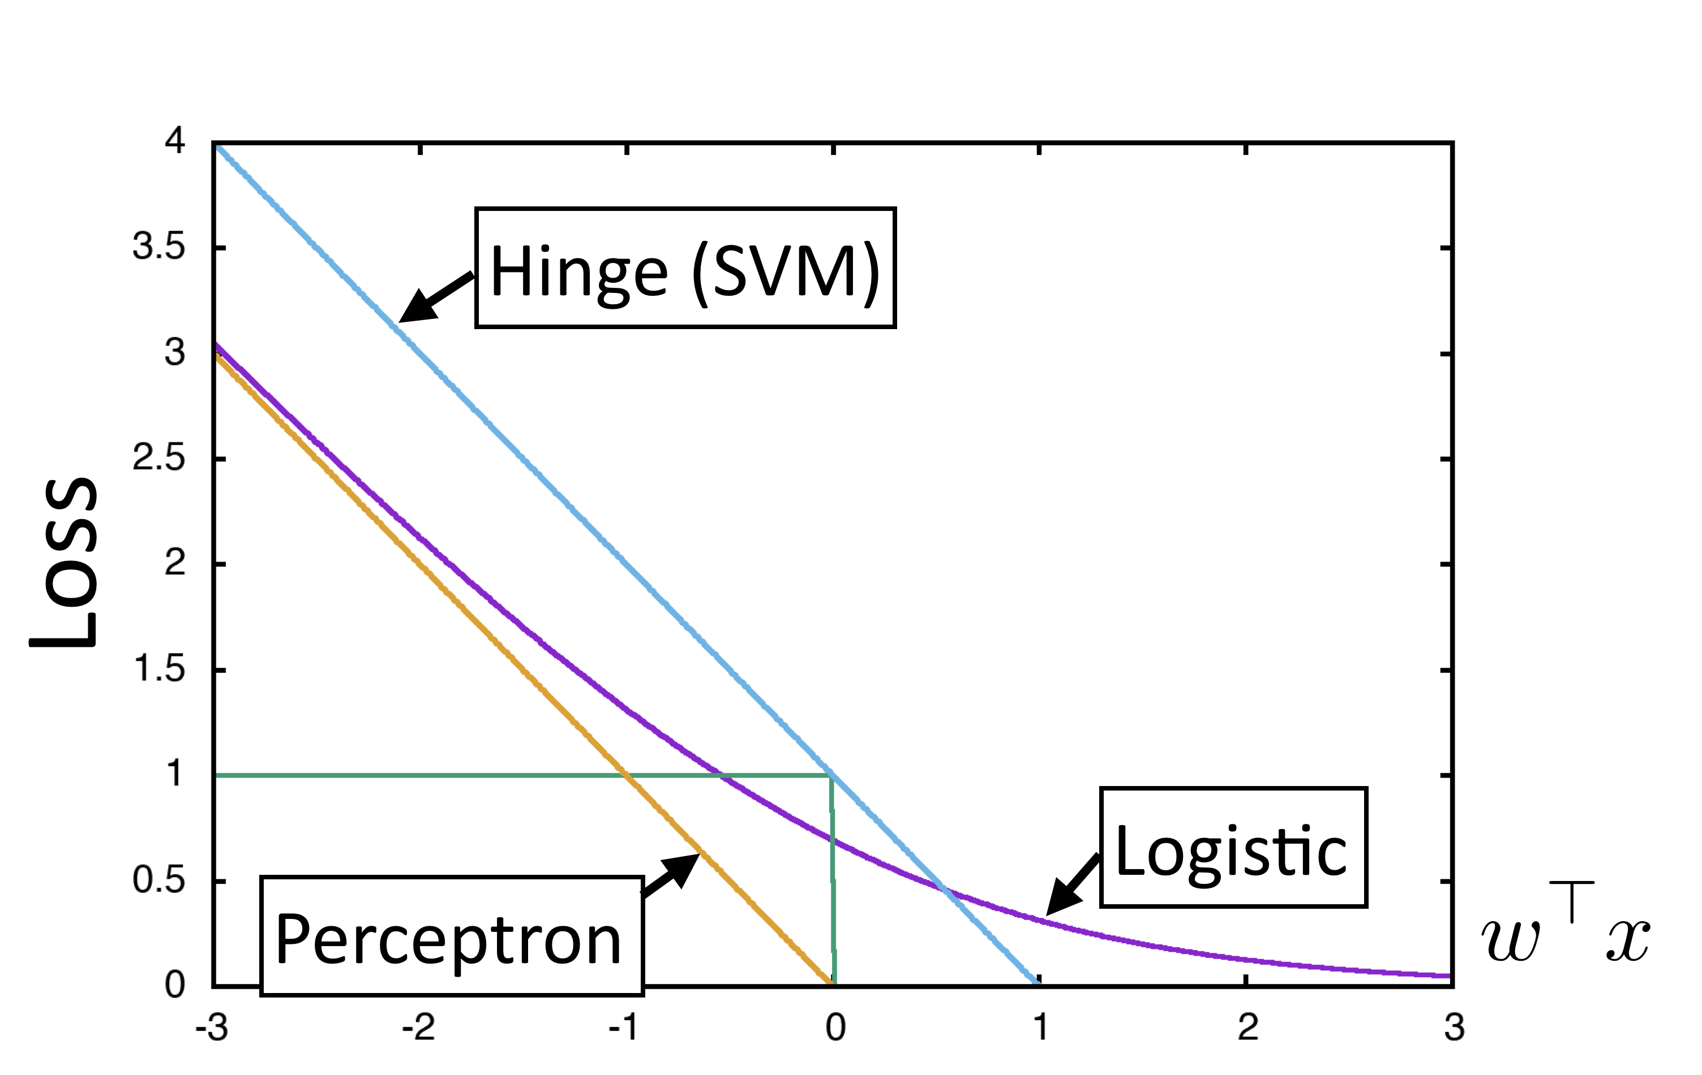
Recap
Four elements of a machine learning method:
Model: probabilistic, max-margin, deep neural network
Objective:
Inference: just maxes and simple expectations so far, but will get harder
Training: gradient descent?

Slide 45
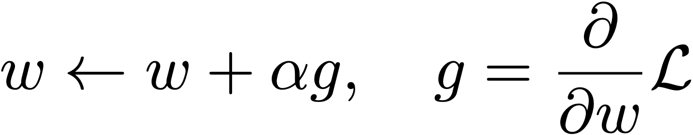
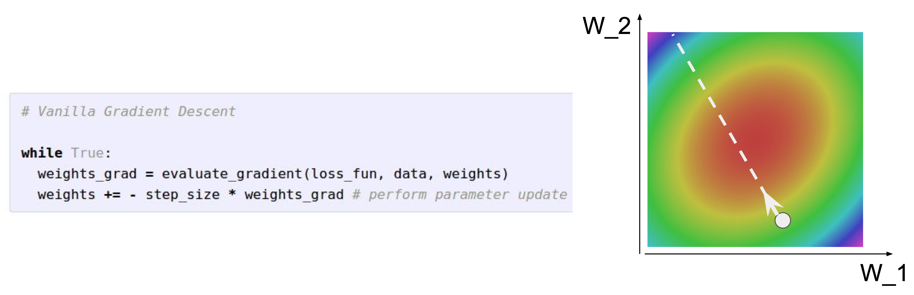
Optimization
Stochastic gradient *ascent*
Very simple to code up
Notes:
%w \leftarrow w + \alpha \frac{\partial}{\partial w} \mathcal{L}
w \leftarrow w + \left({\frac{\partial^2}{\partial w^2} \mathcal{L}}\right)^{-1}\frac{\partial}{\partial w} \mathcal{L}

Slide 46
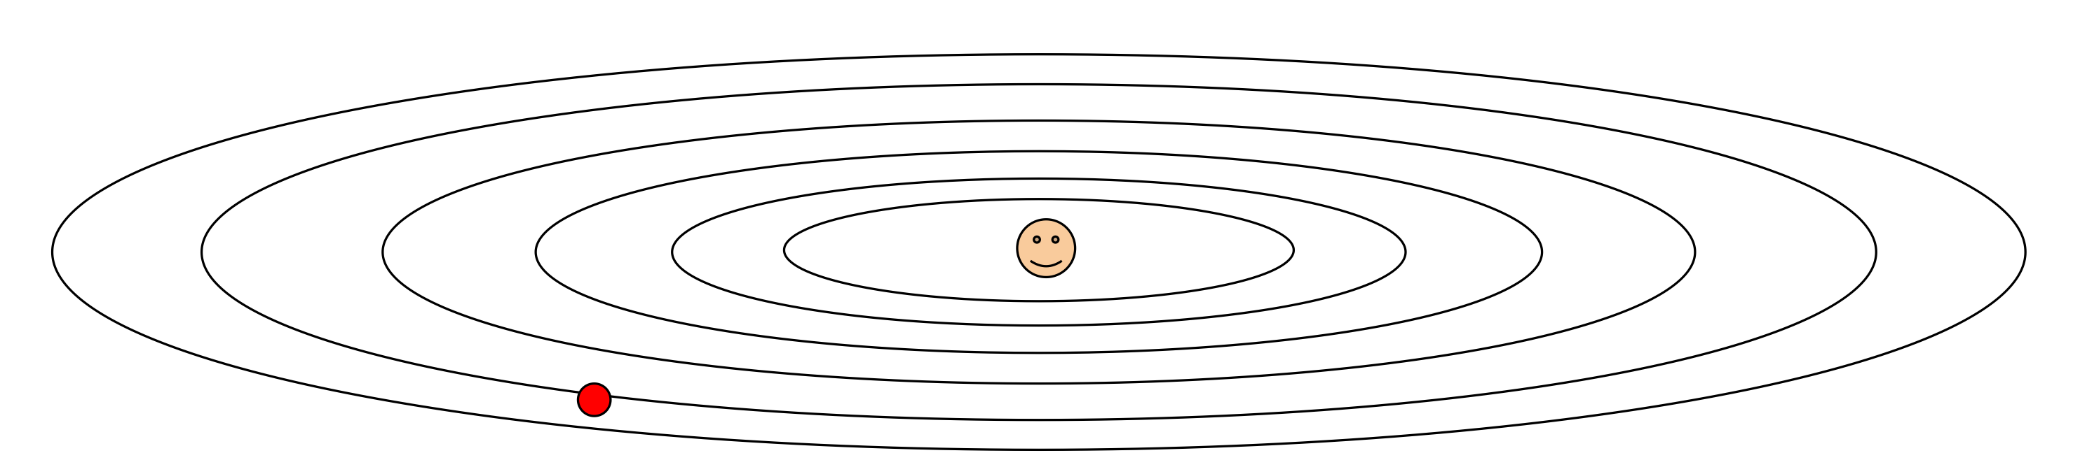
Optimization
Stochastic gradient *ascent*
Very simple to code up
What if loss changes quickly in one direction and slowly in another direction?
Notes:
%w \leftarrow w + \alpha \frac{\partial}{\partial w} \mathcal{L}
w \leftarrow w + \left({\frac{\partial^2}{\partial w^2} \mathcal{L}}\right)^{-1}\frac{\partial}{\partial w} \mathcal{L}

Slide 47
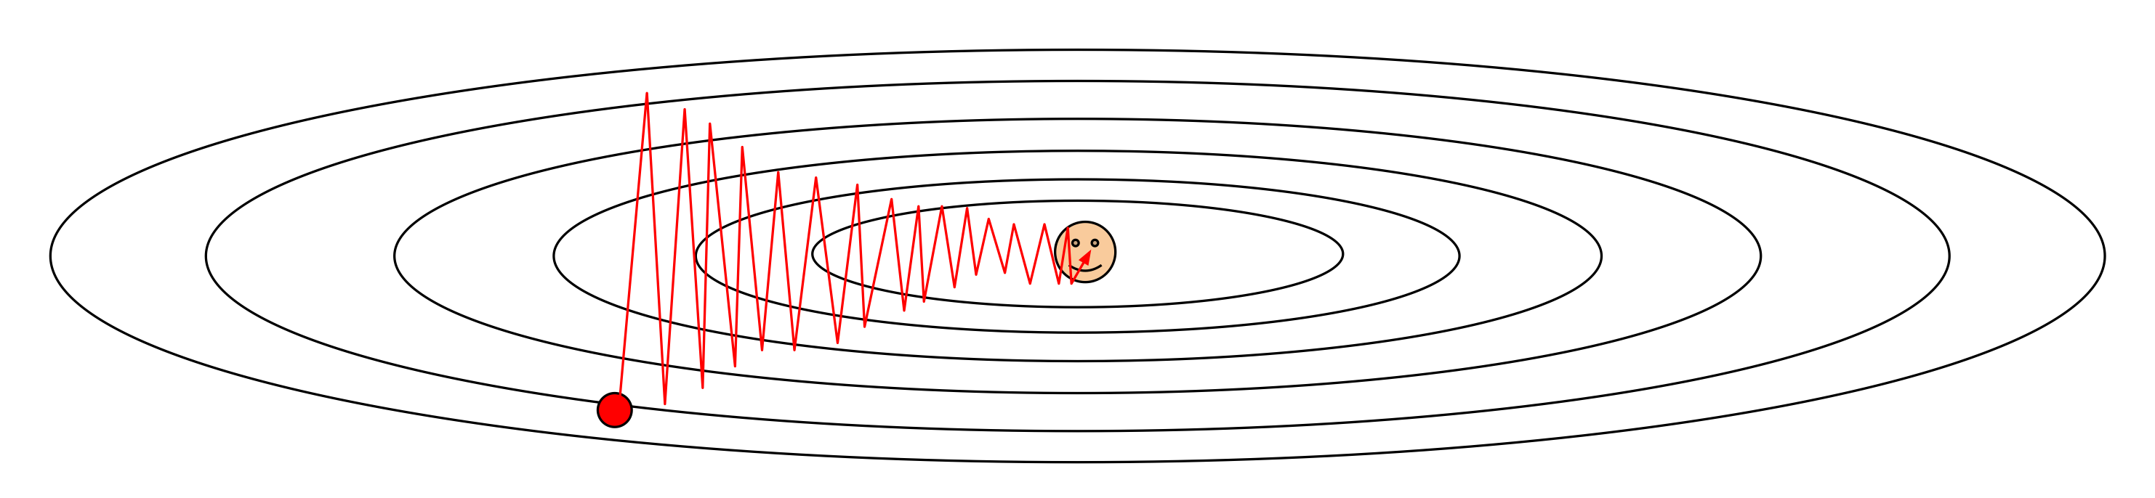
Optimization
Stochastic gradient *ascent*
Very simple to code up
What if loss changes quickly in one direction and slowly in another direction?
Notes:
%w \leftarrow w + \alpha \frac{\partial}{\partial w} \mathcal{L}
w \leftarrow w + \left({\frac{\partial^2}{\partial w^2} \mathcal{L}}\right)^{-1}\frac{\partial}{\partial w} \mathcal{L}

Slide 48
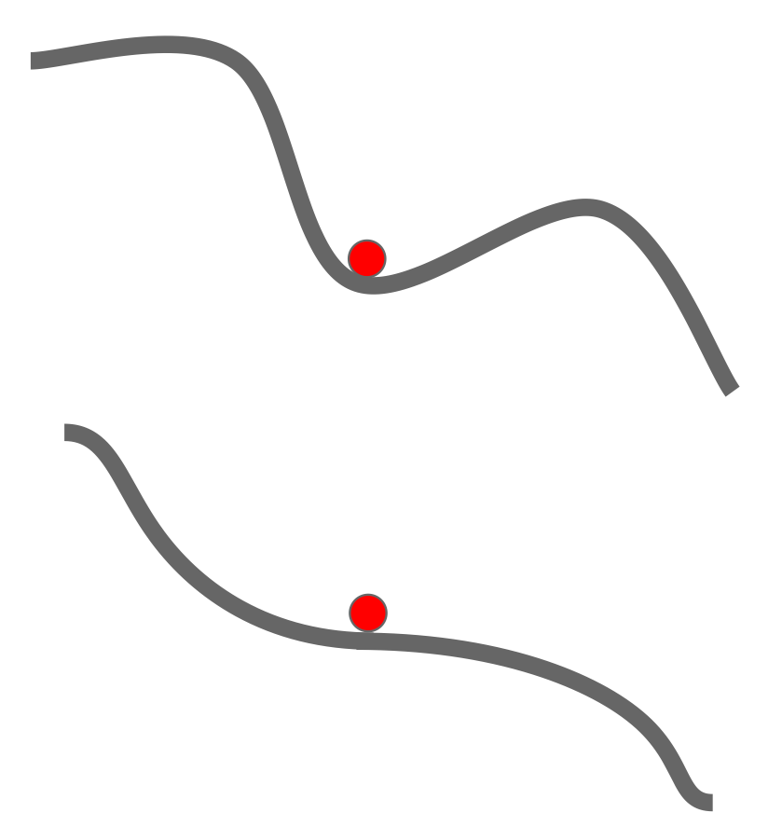
Optimization
Stochastic gradient *ascent*
Very simple to code up
What if the loss function has a local minima or saddle point?
Notes:
%w \leftarrow w + \alpha \frac{\partial}{\partial w} \mathcal{L}
w \leftarrow w + \left({\frac{\partial^2}{\partial w^2} \mathcal{L}}\right)^{-1}\frac{\partial}{\partial w} \mathcal{L}

Slide 49
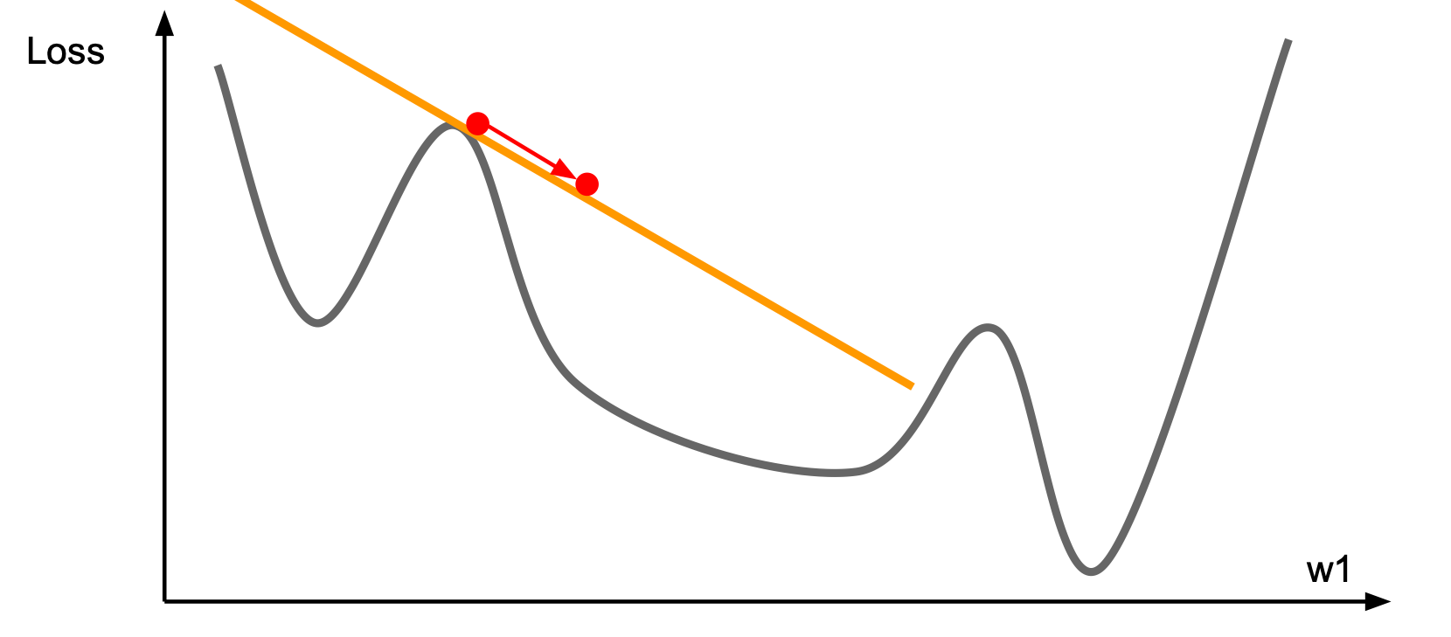
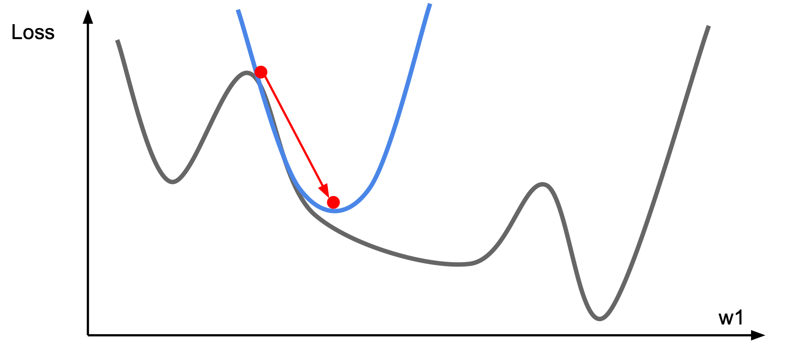
Optimization
Stochastic gradient *ascent*
Very simple to code up
“First-order” technique: only relies on having gradient
Notes:
%w \leftarrow w + \alpha \frac{\partial}{\partial w} \mathcal{L}
w \leftarrow w + \left({\frac{\partial^2}{\partial w^2} \mathcal{L}}\right)^{-1}\frac{\partial}{\partial w} \mathcal{L}

Slide 50
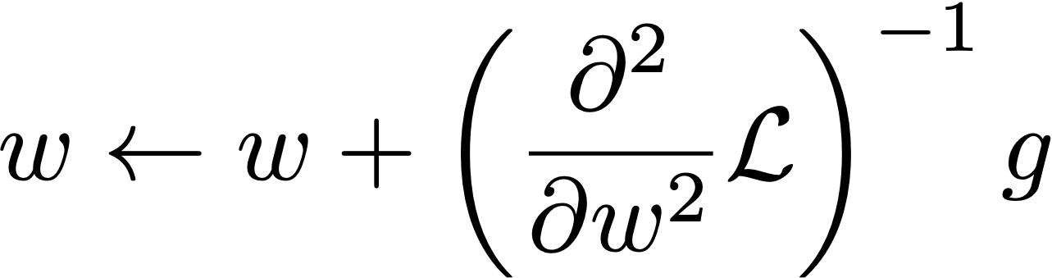
Optimization
Stochastic gradient *ascent*
Very simple to code up
“First-order” technique: only relies on having gradient
Setting step size is hard (decrease when held-out performance worsens?)
Newton’s method
Second-order technique
Optimizes quadratic instantly
Inverse Hessian: n x n mat, expensive!
Quasi-Newton methods: L-BFGS, etc. approximate inverse Hessian
Notes:
%w \leftarrow w + \alpha \frac{\partial}{\partial w} \mathcal{L}
w \leftarrow w + \left({\frac{\partial^2}{\partial w^2} \mathcal{L}}\right)^{-1}\frac{\partial}{\partial w} \mathcal{L}

Slide 51
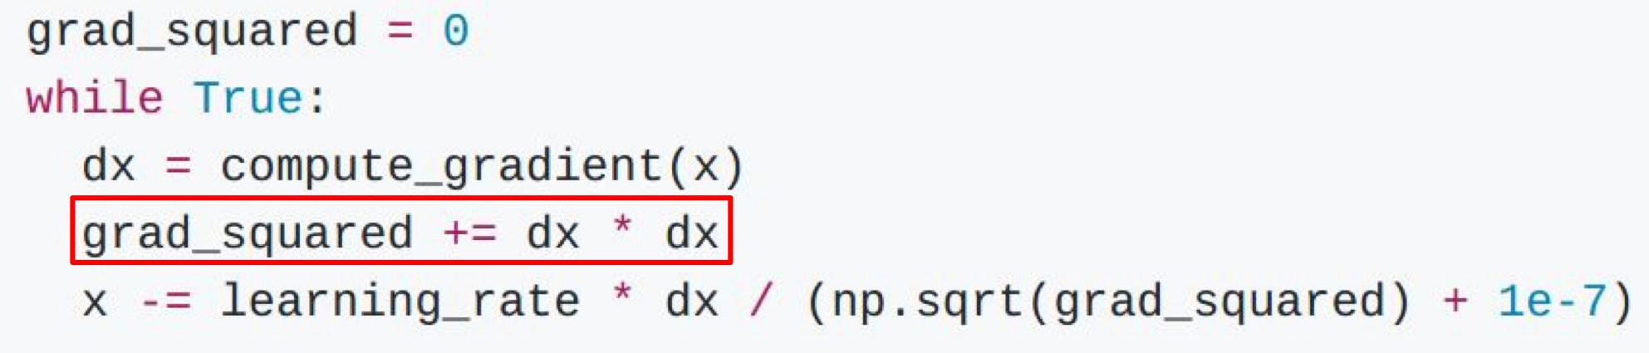
AdaGrad
Optimized for problems with sparse features
Per-parameter learning rate: smaller updates are made to parameters that get updated frequently
Duchi et al. (2011)
Notes:
w_i \leftarrow w_i + \alpha \frac{1}{\sum_{\tau=1}^t g_{\tau,i}^2} g_{t_i}

Slide 52

AdaGrad
Optimized for problems with sparse features
Per-parameter learning rate: smaller updates are made to parameters that get updated frequently
(smoothed) sum of squared gradients from all updates
Generally more robust than SGD, requires less tuning of learning rate
Other techniques for optimizing deep models — more later!
Duchi et al. (2011)
Notes:
w_i \leftarrow w_i + \alpha \frac{1}{\sum_{\tau=1}^t g_{\tau,i}^2} g_{t_i}

Slide 53
Summary
Design tradeoffs need to reflect interactions:
Model and objective are coupled: probabilistic model <-> maximize likelihood
…but not always: a linear model or neural network can be trained to minimize any differentiable loss function
Inference governs what learning: need to be able to compute expectations to use logistic regression

Slide 54
Next Up
You’ve now seen everything you need to implement multi-class classification models
Next time: HMMs (POS tagging)
In 2 weeks: CRFs (NER)

